Slide 1



Data Analysis Report
Author: Junseok Kim

Slide 2









Table of Contents
Executive Summary
Data Analysis
Data Transformation
Recommendation
Data Model
Conclusion
KPIs
Reference List

Slide 3
Executive Summary
Overview
Tools
Recommendation
SQL (SQL Server Management Studio): By utilizing SQL concepts such as CTEs, Window Functions, Views, and JOINs, the data can be efficiently transformed for tasks like data cleaning, filtering, and merging.
Excel: With Excel features like Pivot Tables, Power Query, VLOOKUP, and Nested IF functions, reports can showcase data modeling, KPIs, visualizations, and interactive dashboards.
This report analyzes smart device usage data to uncover key trends that inform Bellabeat's marketing strategy.
By examining user data related to activity, sleep, and weight, the goal is to find:
What are some trends in smart device usage?
How could these trends apply to Bellabeat customers?
How could these trends help influence Bellabeat’s marketing strategy?
Moderate Activity: Most users take 4,000 to 11,999 steps daily, indicating moderate activity levels, with higher activity being less common but still notable.
Sleep Improvement: Bellabeat should focus on promoting sleep tracking and mindfulness features to help users improve their weekday sleep habits.
Hydration for Weight Loss: Promote ‘Spring Water Bottle’ as a key tool for weight management, emphasizing hydration’s role in controlling hunger and boosting metabolism for overweight users.

Slide 4
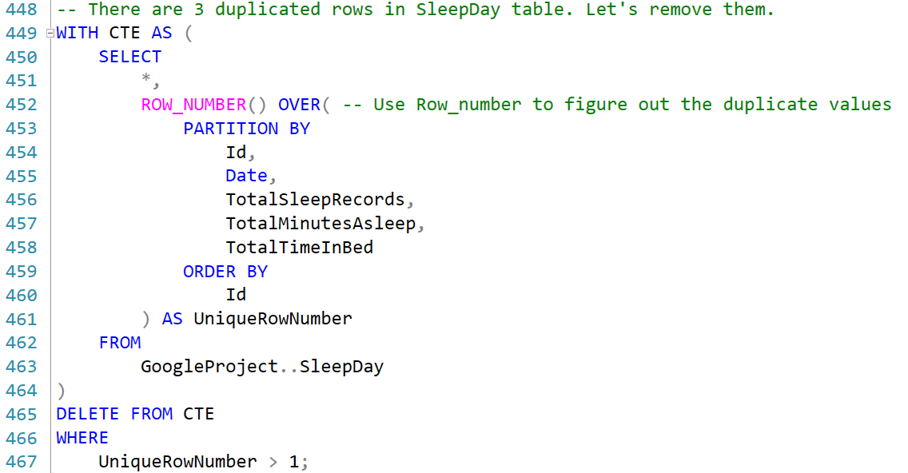
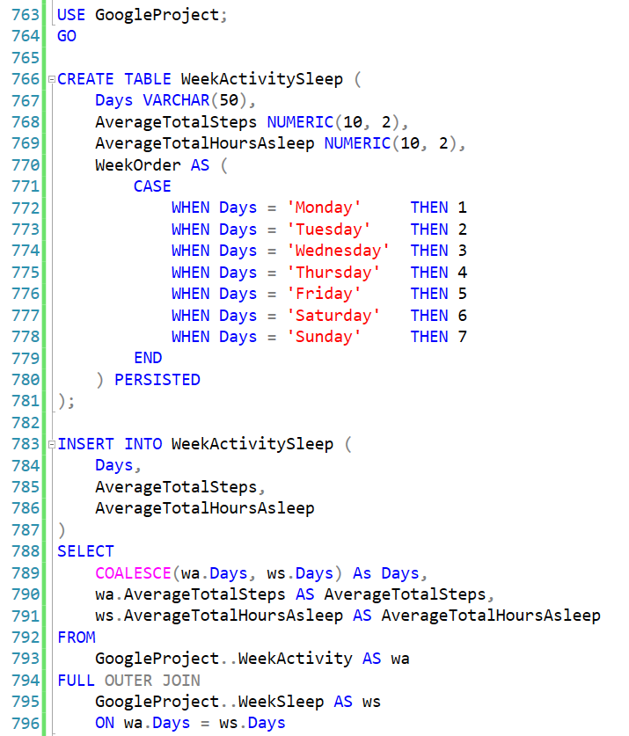
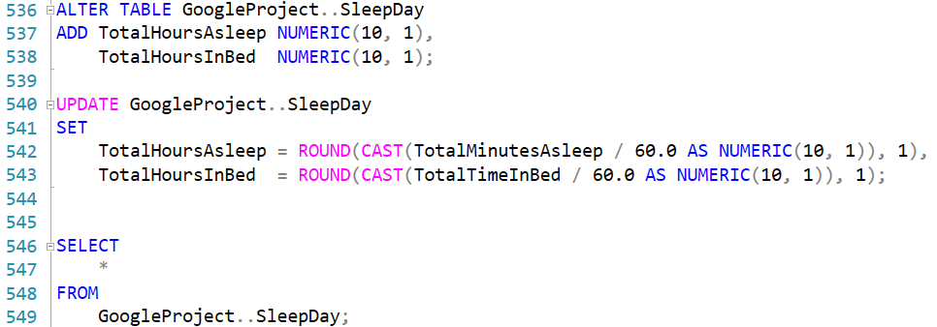
Data Transformation

Slide 5
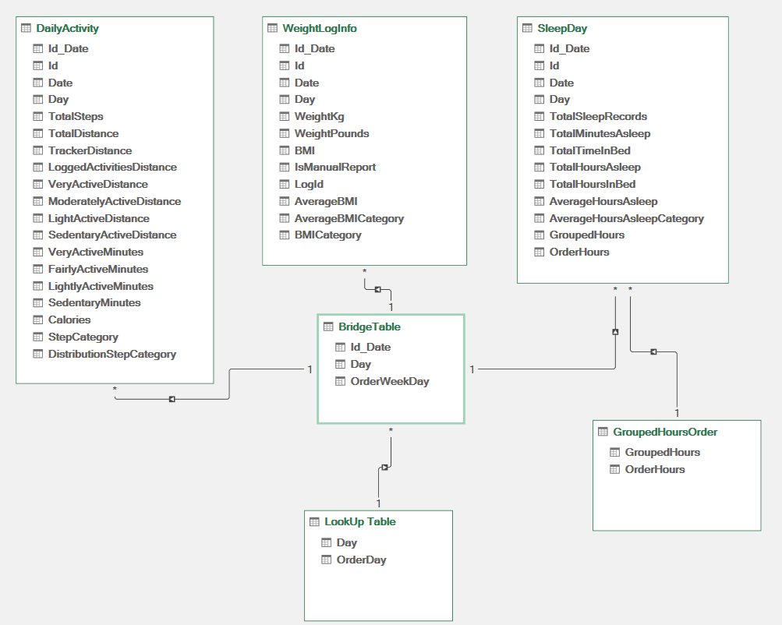
Data Model
Key Highlights
One-To-Many relationships: Links key tables, which will allow multiple records in the BridgeTable to correspond to a single entry in the connected data tables.
BridgeTable: This centralizes data from DailyActivity, WeightLogInfo, and SleepDay using shared identifiers like ID, Date, and Day for integrated and streamlined analysis.
LookUp Table & GroupedHoursOrder: Provides additional reference and categorization, facilitating ordered day mapping and sleep hour grouping for enhanced analysis.

Slide 6
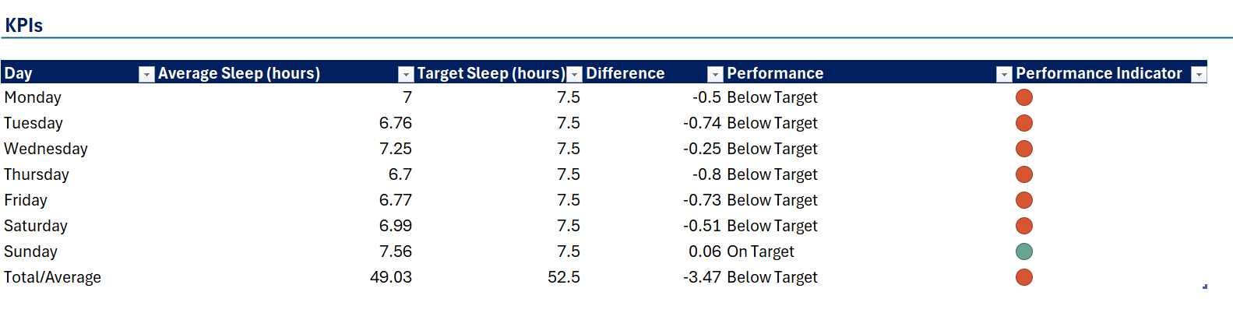
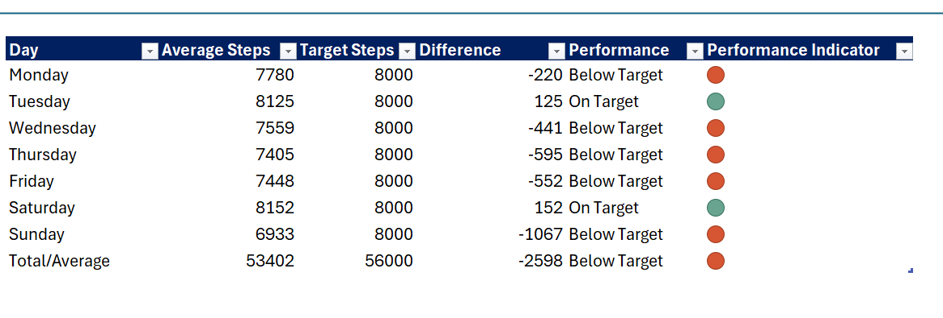
KPIs
Key Highlights
Weekday Sleep Deficit: The participants consistently sleep below the 7.5-hour target on weekdays. The resulting performance shows that insufficient rest could negatively affect productivity and health.
Weekend Recovery: The participants slightly exceed the sleep target on Sunday, suggesting an attempt to recover from the weekday sleep deficit.
Weekday Steps Shortfall: Step counts fall below the 8,000 target on most weekdays, likely due to a sedentary routine or limited time for exercise.
Inconsistent Weekend Activity: While the user exceeds the step target on Saturday and Tuesday, Sunday shows a significant drop in activity with a deficit of 1,067 steps, indicating inconsistent weekend activity.
Note: Recent study suggest that walking 7,500 to 8,000 steps daily is linked to longer life expectancy, implying that it is not necessary to reach 10,000 steps per day to gain health benefits. (Rogers, 2023)

Slide 7
Data Analysis (Activity)
Moderate Activity is Most Frequent: The step ranging between 4,000 and 11,999 steps were the most frequent, with users logging 260, 257, and 247 instances, respectively. This suggests that most users regularly maintain a moderate level of daily activity.
High Activity Occurs Often: The 12,000–15,999 step range has a notable frequency of 133 instances, showing that users frequently reach high activity levels, which could indicate consistent engagement in fitness activities.
Moderate Activity: 21.28% of participants take 7,000-10,000 steps, indicating moderate activity levels.
Low Activity: 46.49% take fewer than 7,000 steps, suggesting a need for BellaBeat to encourage more daily activity.
High Activity: 32.23% exceed 10,000 steps, showing a significant portion is highly active, which BellaBeat can promote as a goal for others.

Slide 8
Data Analysis (Sleep)
7-8 Hours is Most Recorded: With 110 occurrences, 7-8 hours is the most frequently recorded sleep duration. This time range aligns with recommended sleep guidelines. (NIH, 2022)
6-9 Hours is Often Recorded Also: The bars indicating 6-7 hours (83 occurrences) and 8-9 hours (77 occurrences) are also high, indicating that these sleep durations are recorded frequently, even if maybe only by a few people.
Lack of Sleep is Prevalent: While it may seem most people are getting adequate sleep, the data from the previous graph shows irregularly recorded data over a certain period of time. Depending on who recorded many times and who didn’t, the data became askew. When the average of this data is taken in hopes to level out the discrepancies, it shows that 13 out of the 24 participants experienced insufficient sleep, indicating a common issue within the group.
Balanced Sleep is Achievable: Still, 10 participants maintained healthy sleep habits, proving that sufficient sleep is very attainable.

Slide 9
Data Analysis (Weight)
Most Frequent BMI Range is 25-26: The 25-26 BMI range has the highest frequency, indicating that users frequently check their BMI when it falls in the "overweight" category.
Moderate BMI Ranges are Common: BMI ranges between 23-25 and 24-25 also have significant data, suggesting that users often monitor their BMI around the normal-to-overweight threshold.
Note:
- BMI < 18.5 = Underweight. - BMI > 25 = Overweight
- BMI > 30 = Obesity (WHO, 2024)
Overweight Category is Most Common: The largest number of participants, 4 out of 8, fall into the "Overweight" BMI category, indicating this is the most prevalent group.
Healthy Weight is Significant: 3 participants are classified as having a "Healthy Weight," showing that a substantial proportion of the group maintains a normal BMI.

Slide 10
Data Analysis
Positive Correlation: There is a positive correlation between total steps and calories burned, meaning that in general, more steps are associated with higher calorie expenditure.
Strong Data Integrity: While there are a few outliers, they are not extreme, which indicates the data integrity is relatively strong.
Participant Clustering: Most participants cluster around 10,000 steps and burn between 2,000 to 3,000 calories.
Positive Relationship: There is a positive relationship between very active minutes and calories burned, indicating that more intense activities like running or biking result in higher calorie expenditure.
Participant Clustering: Most participants cluster around 0 to 50 very active minutes, with calories burned ranging between 2,000 to 3,000 calories.
Calorie Burn Plateau: After 150 minutes of intense activity, additional exercise offers diminishing calorie benefits.

Slide 11
Data Analysis
Positive Correlation: There is a strong positive correlation between total time in bed and total time asleep, meaning that as participants spend more time in bed, they tend to sleep longer.
Sleep Plateau: After 600 minutes in bed, the increase in sleep time begins to plateau, indicating that spending more time in bed beyond this point does not lead to significantly longer sleep duration.
Non-linear Relationship: Sleep initially increases with sedentary time but declines after 600 minutes.
Optimal Sedentary Range: Participants with 400-600 sedentary minutes get the most sleep, suggesting moderate sedentary time improves sleep.
Negative Impact of Excessive Sedentary Time: After 600 sedentary minutes, sleep duration sharply decreases, indicating a negative effect of excessive sedentary behavior on sleep.

Slide 12


Recommendation
01
02
03
During weekdays, users consistently sleep below the target of 7.5 hours. Bellabeat can provide personalized recommendations for improving weekday sleep, promoting products such as their Time Wellness Watch or Leaf Tracker, which monitor sleep and stress levels.
According to the pie chart, 46.49% of the users take less than 7,000 steps daily. Bellabeat should push notifications or suggestions via their Bellabeat app to encourage these users to increase their daily activity. Personalized challenges or reminders to move could be effective strategies for this user segment.
Since 13 participants fall into the "Lack of Sleep" category, Bellabeat can create targeted campaigns focused on improving sleep quality. The Bellabeat app’s sleep tracking and mindfulness features can be emphasized, offering personalized suggestions for users struggling with insufficient sleep. Promoting the importance of sufficient rest could resonate well with this large segment.

Slide 13
Recommendation
04
05
06
The majority of participants are in the Overweight category (4). Hydration is crucial for this group because it aids weight management by controlling hunger, boosting metabolism, and improving health. Bellabeat can promote the Spring Water Bottle as a key tool for weight loss, offering personalized hydration goals and reminders through the app to help users in these categories stay on track with their water intake and weight goals.
Correlation graphs suggest that increasing total steps is useful but very active minutes result in more efficient calorie burn. Bellabeat can market a balanced fitness approach where users are encouraged to achieve a combination of both steps and high-intensity activities. Campaigns could focus on promoting features like heart rate monitoring and intensity tracking via Leaf and Time, which would appeal to users interested in both moderate and high-intensity workouts.
Other Correlation graphs highlight the importance of a balanced lifestyle. Bellabeat should market a holistic wellness approach through its product ecosystem, combining activity tracking with sleep optimization. Campaigns can focus on how Leaf and Time help users balance their daily activities and rest, emphasizing that good sleep requires healthy daytime and nighttime habits

Slide 14
Conclusion
Business Objective
Actionable Insights
Identify smart device usage trends
Apply insights to Bellabeat customers' behavior
Develop marketing strategies to boost engagement and wellness
Promote hydration for weight management using the Spring Water Bottle
Use Bellabeat apps to enhance sleep features to address user sleep deficits
Encourage high-intensity activities for optimal calorie burn via Leaf, and Time products
Key Findings
Recommendations
50% of users fall into overweight/obese categories
Insufficient sleep is common among users
Active minutes strongly correlate with calorie burn
Target users with high BMI through hydration-focused campaigns
Offer personalized sleep improvement content
Highlight active minutes in marketing for better fitness engagement

Slide 15
THANKS FOR WATCHING!

Slide 16
References
National Heart, Lung, and Blood Institute (NIH) (2022) How much sleep is enough? 24 March. Available at:
https://www.nhlbi.nih.gov/health/sleep/how-much-sleep (Accessed: 10 September 2024).
Rogers, M. (2023) Do you actually need to walk 10,000 steps a day? Blue Cross and Blue
Shield of North Carolina, 13 March. Available at: https://www.bluecrossnc.com/blog/healthy-living/fitness/walk-10000-steps-a-day (Accessed: 10 September
2024).
World Health Organization (WHO) (2024) Body mass index (BMI). Available at: https://www.who.int/data/gho/data/themes/topics/topic-details/GHO/body-mass-index (Accessed: 10 October 2024).

Slide 17
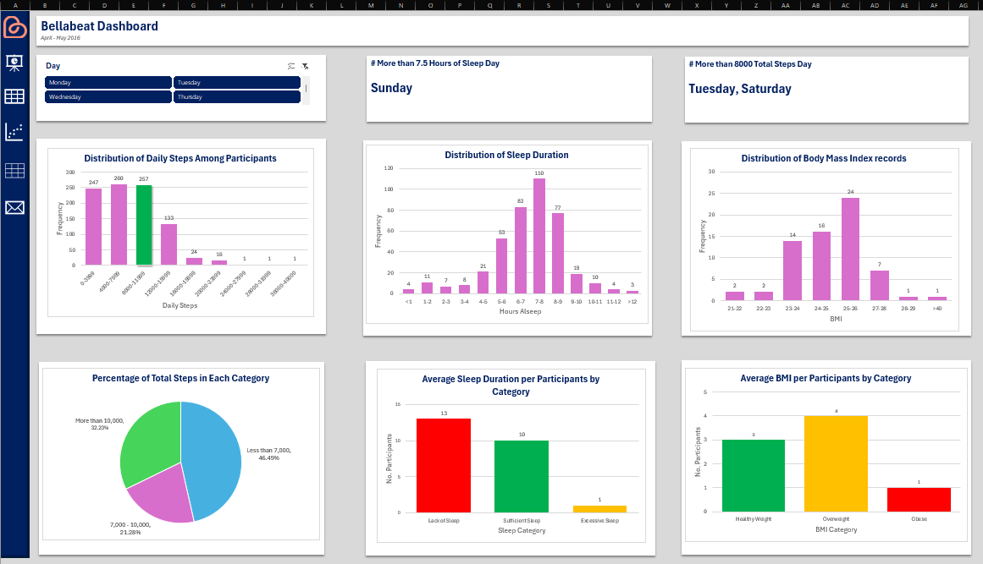
Appendix 1 (Dashboard)
Ceo Of Ingoude Company

Slide 18
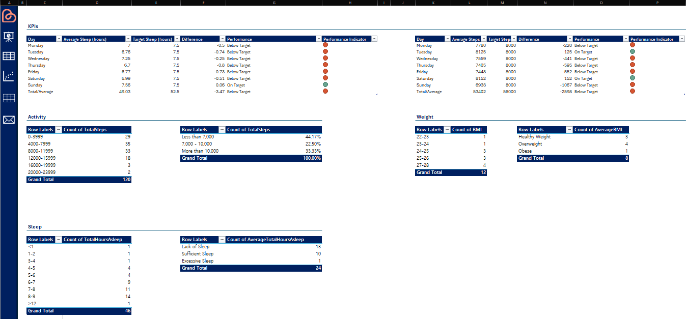
Appendix 2 (Dashboard)
Ceo Of Ingoude Company

Slide 19
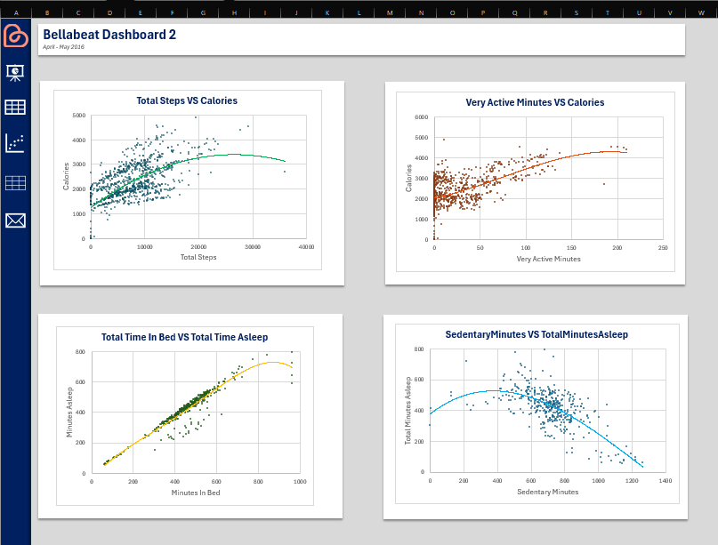
Appendix 3 (Dashboard)
Ceo Of Ingoude Company

Slide 20
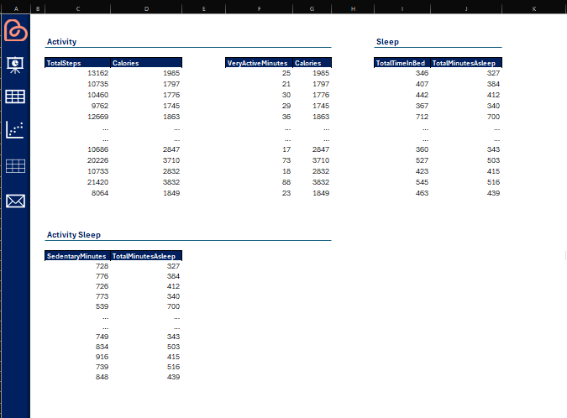
Appendix 4 (Dashboard)
Ceo Of Ingoude Company

